Slide 1
SaaS Customer Churn Analysis & Retention Experiment Design
Behavioral Analysis, Product Friction, and Risk-Based Intervention Design
Created by - Deeksha Gosain

Slide 2



OUTLINE
Executive Summary
Introduction
Methodology
Results
  Visualization – Charts
  Dashboard
Discussion
  Findings & Implications
Conclusion
Appendix

Slide 3

EXECUTIVE SUMMARY
This project was conducted to diagnose rising customer churn in a subscription-based SaaS product, with the objective of identifying early churn drivers and enabling targeted retention interventions.
Customer churn increased sharply starting early 2024, signaling a structural retention issue rather than random attrition.
Cohort analysis revealed a steep retention drop within the first 1–3 months after signup, leading to the definition of early churn as churn within the first 90 days.
Behavioral analysis uncovered a counterintuitive pattern: highly engaged trial users churned more than low-engagement users.
Further investigation showed churn was driven by product friction (early-life errors) rather than lack of activation or usage.
A churn risk model identified - a high-risk segment with ~70% early churn, compared to ~21% early churn among lower-risk users.
Overall, results indicate that early churn is primarily a product experience and reliability problem, making error reduction during early usage the highest-impact retention lever.

Slide 4

INTRODUCTION
This project analyzes SaaS Subscription & Churn Analytics Dataset (Kaggle),a synthetic dataset representing a subscription-based software company with customer accounts, subscriptions, churn and product usage data.
The project is guided by three core analytical questions:
  Is customer churn worsening over time, and is the increase structural rather than random?
  When in the customer lifecycle does churn primarily occur, based on signup cohorts?
  Which early behavioral signals (engagement and product friction) are associated with early churn?
The goal of the analysis is to move from high-level churn metrics to behavior-driven insights that explain why customers churn and who should be prioritized for retention efforts.
The findings demonstrate how combining cohort analysis, behavioral feature engineering, and churn risk modeling can translate raw subscription and usage data into actionable retention strategy and experiment design insights for a SaaS business.

Slide 5

METHODOLOGY
Collection & Data Preparation (SQL & Python)
  Used the SaaS Subscription & Churn Analytics Dataset (Kaggle) and loaded it into SQLite database
  Created SQL views to serve as a single source of truth for churn KPIs
2. Exploratory Data Analysis
  Analyzed monthly churn trends and active account growth
  Examined churn distribution by trial status, industry, and geography
3. Cohort Analysis
  Built signup-month cohorts to analyze retention over time
  Used retention heatmaps to identify early lifecycle drop-offs
4. Behavioral Feature Engineering
  Engineered early-life behavioral metrics (first 30 days):
    Engagement (active days, usage events, features used)
    Friction (error counts, errors per active day)
  Segmented users into activation-based behavioral cohorts

Slide 6
METHODOLOGY
5. Churn Risk Modeling
  Trained an interpretable logistic regression model using early behavioral features
  Generated churn risk scores to rank users by early churn likelihood
  Evaluated separation between high-risk and low-risk user segments
6. Experiment & Dashboard Design
  Designed a targeted A/B testing framework focused on high-risk trial users
  Defined success metrics and statistical evaluation approach
  Built a BI dashboard to monitor churn KPIs, cohort retention, behavioral insights, and risk segmentation

Slide 7
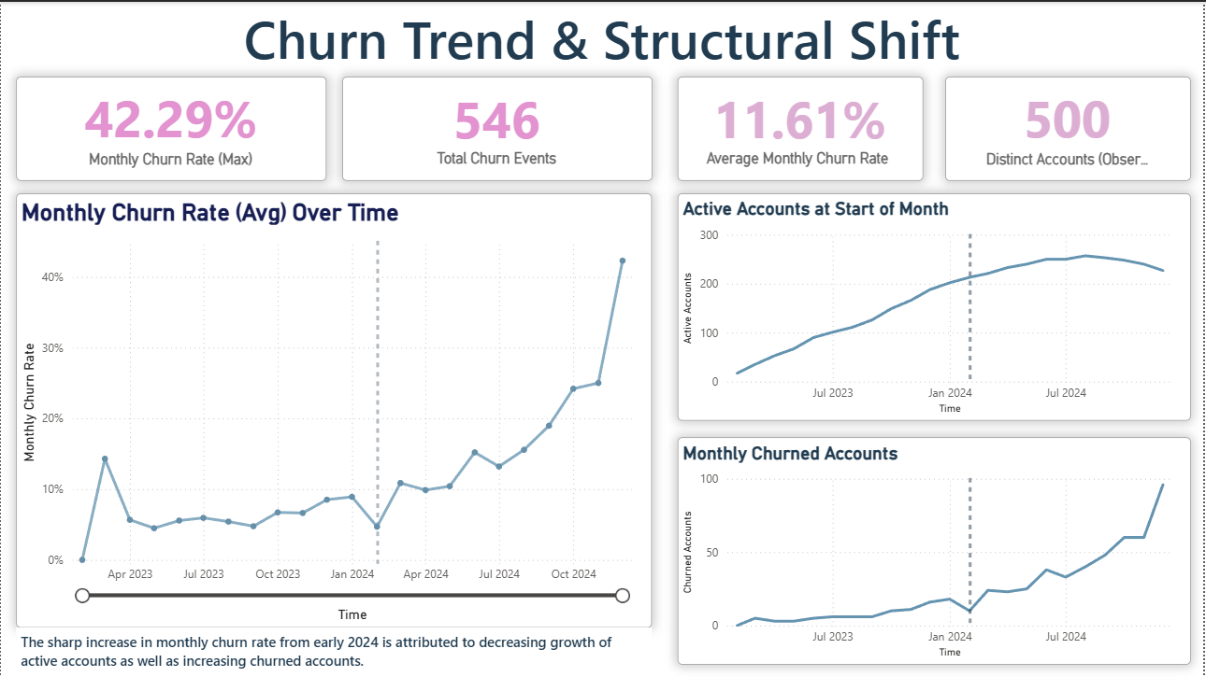
DASHBOARD TAB 1

Slide 8
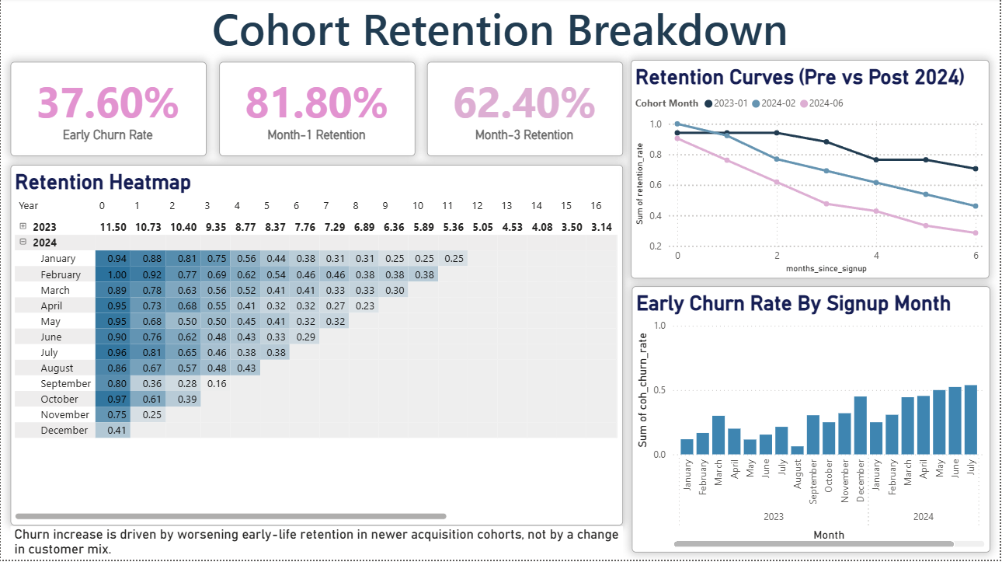
DASHBOARD TAB 2

Slide 9
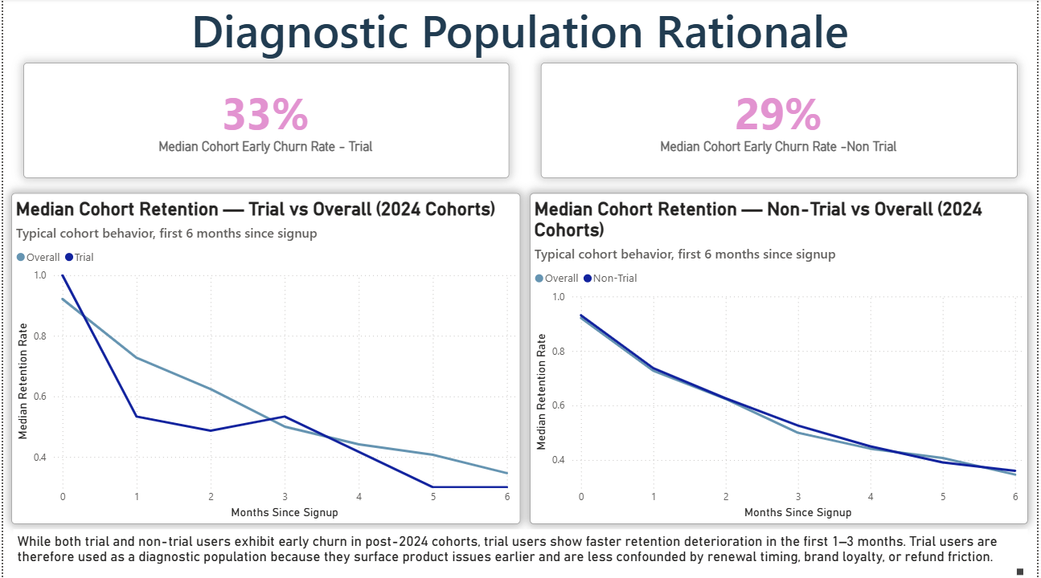
DASHBOARD TAB 3

Slide 10
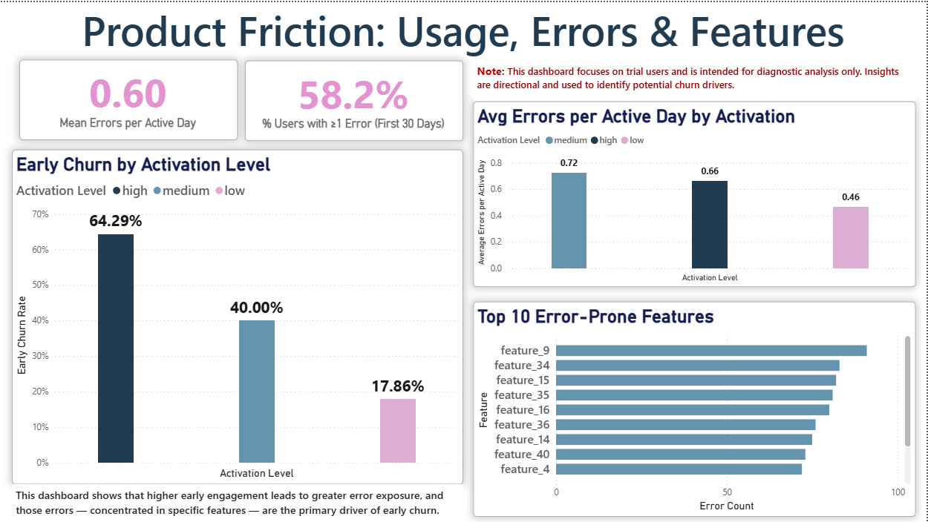
DASHBOARD TAB 4

Slide 11
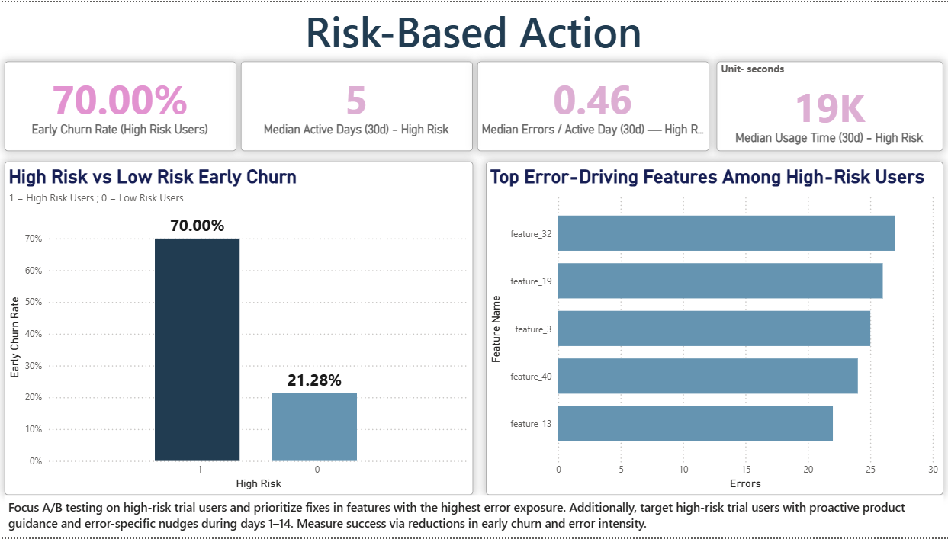
DASHBOARD TAB 5

Slide 12
OVERALL FINDINGS & IMPLICATIONS
Findings
Customer churn increased structurally over time, with a sharp rise observed from early 2024 rather than random month-to-month variation.
Early churn is concentrated within the first 90 days after signup, indicating that customer outcomes are largely decided early in the lifecycle.
Product friction (errors) increases with engagement intensity, exposing active users to more failure points.
Behavioral cohorts based on early activation show clear churn separation, outperforming static attributes such as plan tier.
Churn risk modeling identifies a high-risk segment where ~70% of users churn early, compared to ~21% among lower-risk users.
Implications
Retention efforts should prioritize early lifecycle intervention like improving onboarding quality and early lifecycle intervention, rather than focusing on long-tenure customers.
Reducing early product friction is a key retention lever, especially for highly engaged users.
Product experience improvements are likely to yield higher retention impact than market-level segmentation alone
Risk-based prioritization allows retention teams to focus on users with the highest churn likelihood, maximizing ROI.

Slide 13

CONCLUSION
The analysis demonstrates that customer churn in this SaaS environment is driven primarily by early lifecycle behavior, with a significant portion of churn occurring within the first 90 days after signup rather than later in the customer journey.
Cohort and behavioral analysis reveal that churn is not caused by lack of engagement, but by friction experienced during early product usage, particularly among highly engaged trial users who encounter elevated error rates.
Risk-based segmentation shows that early churn is highly concentrated within a small subset of power users, enabling targeted retention efforts to be significantly more effective than broad, population-wide interventions.
Overall, the findings highlight the value of combining cohort analysis, behavioral feature engineering, and churn risk modeling to move from descriptive churn metrics to actionable retention strategy and experiment-driven decision-making in a SaaS context.

